Slide 1
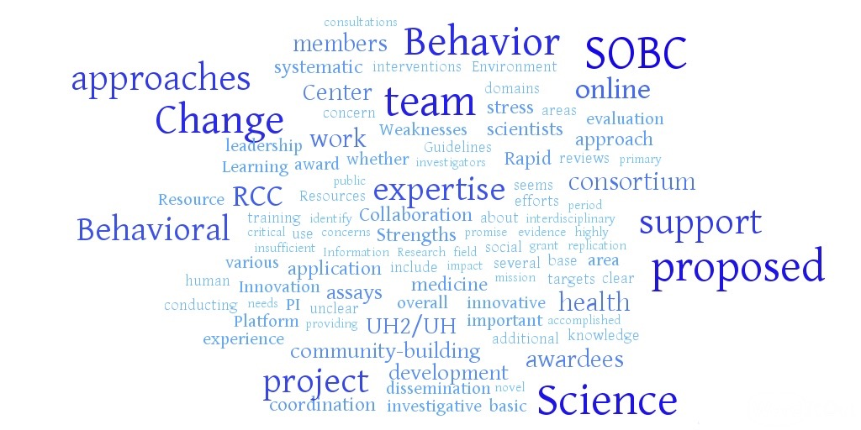



Columbia University Science of Behavior Change Resource and Coordinating Center
Karina W. Davidson

Slide 2
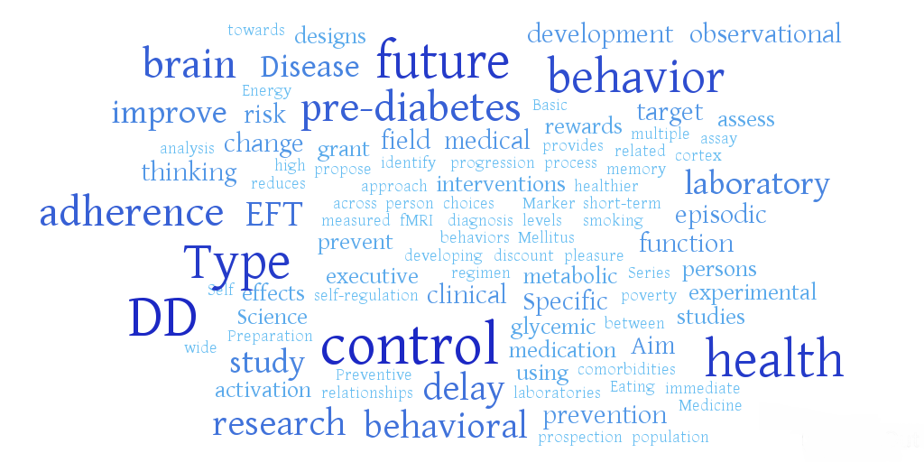
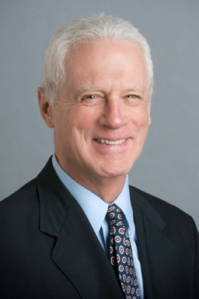


Delay discounting as a target for self-regulation in prediabetes
Leonard H. Epstein Warren K. Bickel

Slide 3
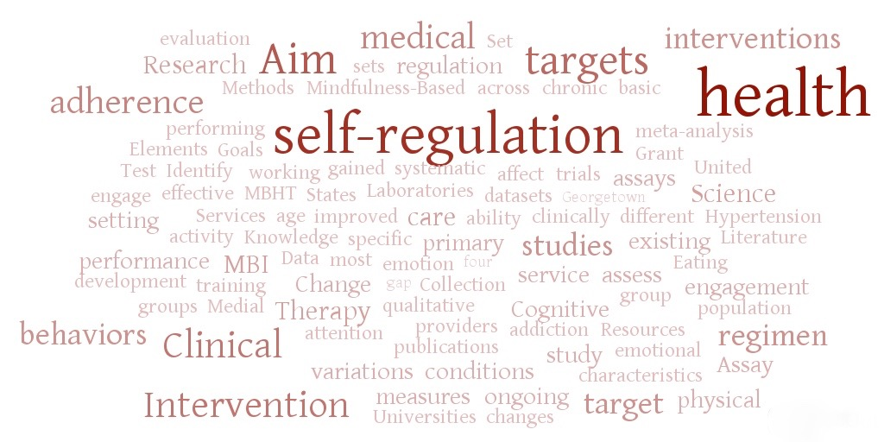

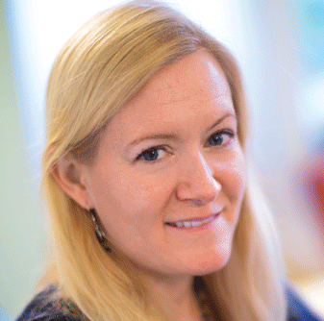


Mindfulness influences on self-regulation: Mental and physical health implications
Eric Loucks
Willoughby Britton
Jean A. King

Slide 4
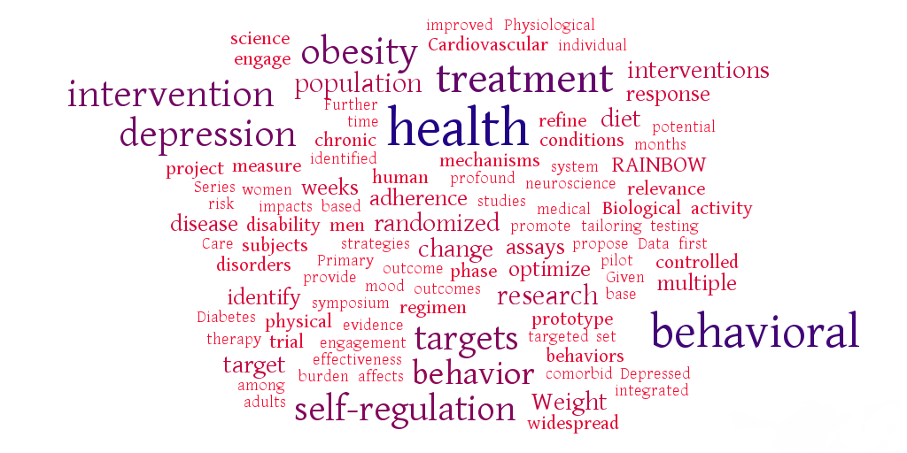
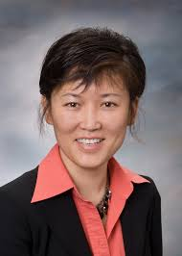


Engaging self-regulation targets to understand the mechanisms of behavior change and improve mood and weight outcomes
Jun Ma
Leanne Williams

Slide 5
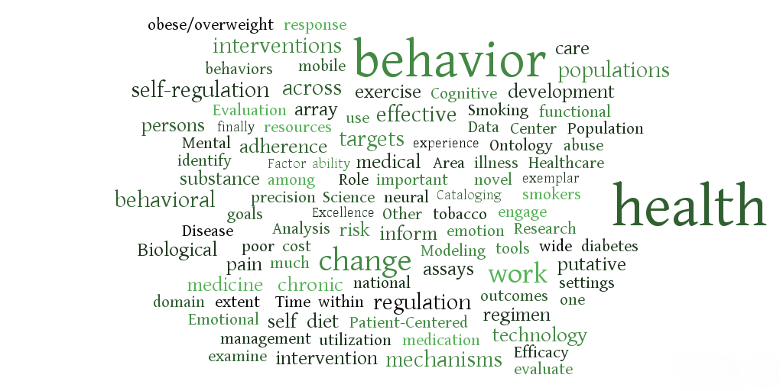



Applying novel technologies and methods to inform the ontology of self-regulation
Lisa A. Marsch
Russell A. Poldrack

Slide 6
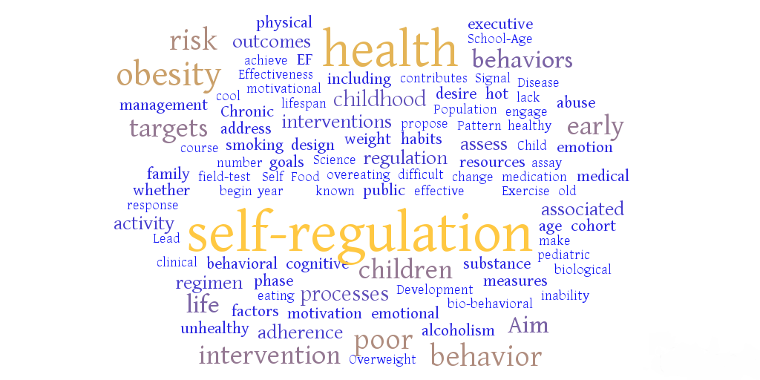


Targeting self-regulation to promote adherence and health behaviors in children
Alison L. Miller

Slide 7
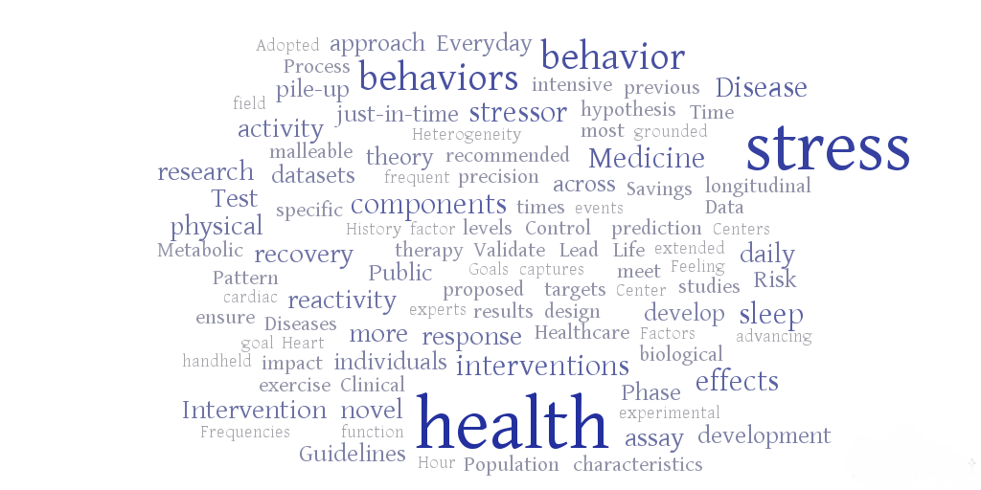

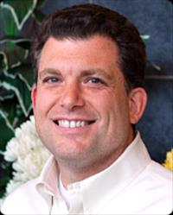

Everyday stress response targets in the science of behavior change
David M. Almeida
Joshua M. Smyth

Slide 8
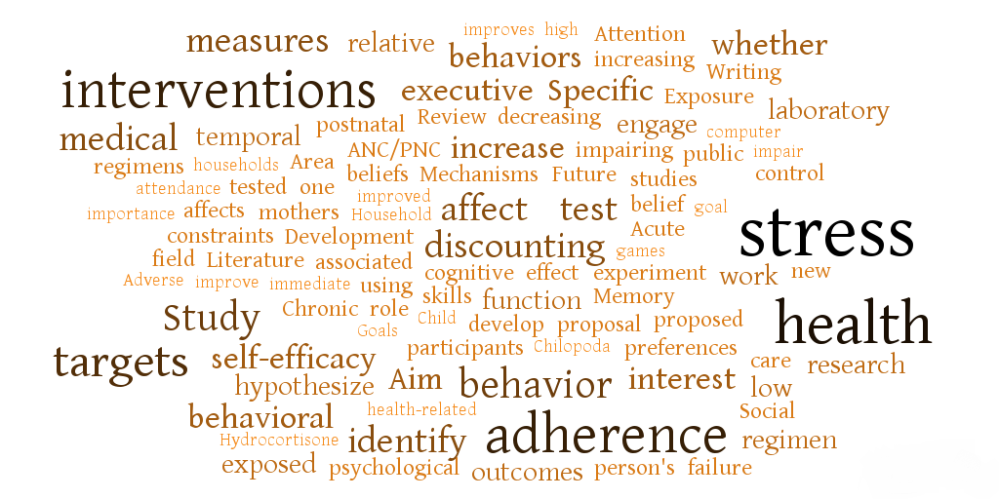


How does stress affect health behaviors: Preferences, beliefs, or constraints?
Johannes A. Haushofer

Slide 9
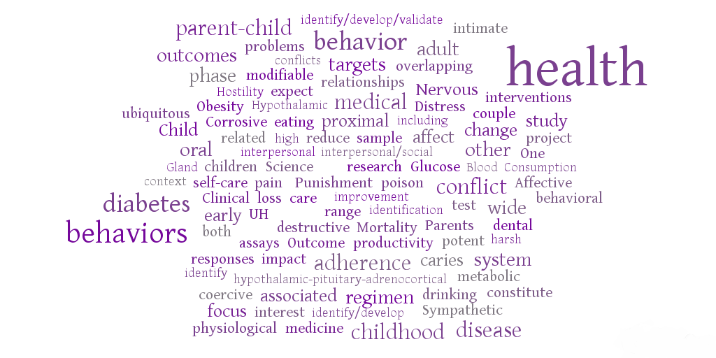







Targeting corrosive couple conflict and parent-child coercion to impact health behaviors and regimen adherence
Amy M. Smith Slep
Tessa V. West
Theodore Beauchaine
Richard Heyman
Robert Levenson
Antoinette M. Schoenthaler

